Slide 1
Decentralized Charity Platform

Slide 2
Motivation and Problem
Motivation: "I was inspired by the need for a solution that allows people to donate with confidence, knowing their contributions go directly to the intended charity and that transactions are fully transparent."
Objective: "My goal is to create a decentralized charity platform where users can donate ETH to various verified charities, and the transactions are recorded securely on the blockchain."

Slide 3
Blockchain Integration
Transparency: Blockchain records every donation, and anyone can verify the transaction history via smart contracts.
Security: By using blockchain, each donation transaction is immutable, ensuring no one can alter the details or redirect funds.
Decentralization: By utilizing a decentralized platform, the middlemen are removed, ensuring that the charity receives the full donation.

Slide 4
Implementation Details
Frontend (User Interface)
Built using React.js, allows users to browse charities, select one, and donate Ethereum (ETH) through MetaMask.
Smart Contracts (Blockchain Layer)
Deployed on Ethereum using Solidity, handles charity management, donation processing, and ensures transparency by recording all donations on the blockchain.

Slide 5
Implementation Details
MetaMask Integration
Users connect their MetaMask wallet for donation transactions, allowing secure ETH donations directly to selected charities.
Donation Transparency
Blockchain ensures complete transparency, with every donation verified and recorded on the Ethereum ledger for accountability.

Slide 6
System Architecture
Blockchain Layer: Ethereum Smart Contracts
Select charity
Donation amount
Donation status
Frontend Layer: React.js with Web3.js
User Interface for interacting with smart contracts
MetaMask integration for wallet management

Slide 7
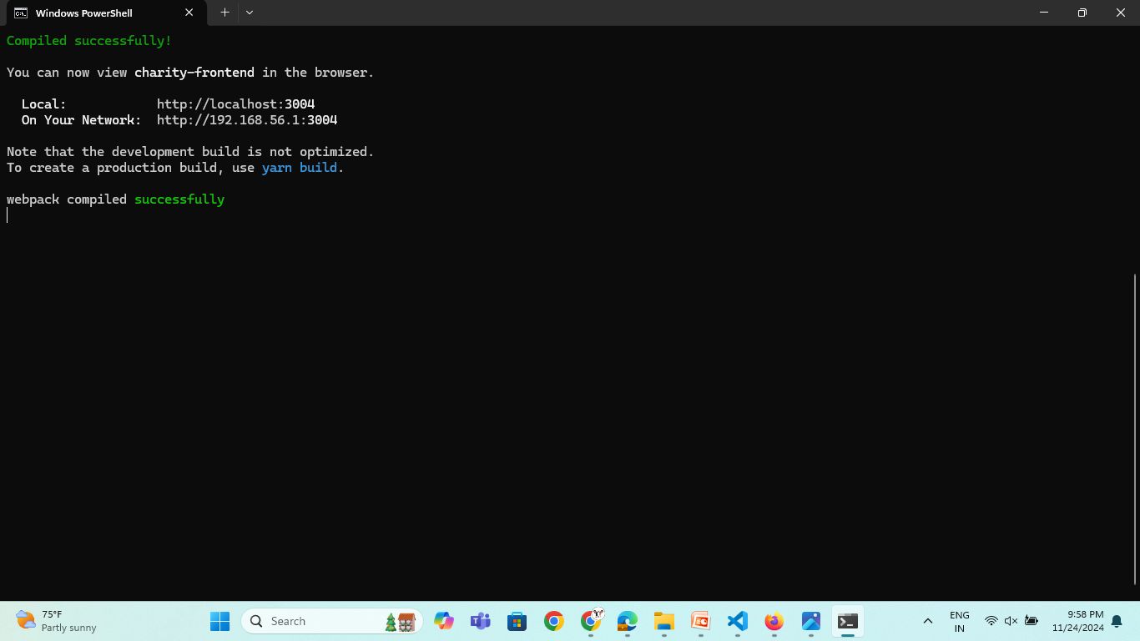
Demo

Slide 8
Demo
https://drive.google.com/file/d/1DGy8Q1fzHXwfHaW3J9Y8bvORckP1BG6q/view?usp=sharing

Slide 9
Conclusion
The Decentralized Charity Platform allows users to donate directly to verified charities using Ethereum smart contracts, ensuring transparency and security. It enables users to select charities, make donations in ETH, and track their donation history, all while interacting with the Ethereum blockchain through MetaMask. The platform relies solely on smart contracts deployed on the blockchain to manage donations. This project demonstrates how blockchain can provide a trust and trustless and decentralized approach to charitable donations

